Slide 1
CS446
SUMMER INTERNSHIP - II
PREPARED BY : HARSHBHAI PATEL (D22CS099) AND KRISH PATEL (D22CS094)
--------------------------------------------------------------------------------------------------------
MENTORED BY : HITEN PATEL || EMPLOYEE AT: CAMPUSKNOT EDU. PVT. LTD

Slide 2
AGENDA
Introduction to Technology
Implementation of projects
(screen shots)
Definition of Projects
Roles and Responsibilities
Advantages of Internship

Slide 3
INTRODUCTION TO TECHNOLOGY
REACT.JS
React.js is an open-source JavaScript library written in JavaScript, primarily maintained by Facebook.
It offers a component-based architecture, allowing developers to build encapsulated components that manage their own state and compose them to create complex user interfaces.
Additionally, React.js virtual DOM improves performance by minimizing direct manipulation of the browser's DOM, leading to more efficient updates and rendering.

Slide 4
DEFINITION OF PROJECT’S
SOCIAL ECHO
The app features a comprehensive directory of diverse communities, allowing users to explore and join groups that align with their interests and passions.
The platform enables users to interact with community members through posts, comments, and direct messages, fostering meaningful social connections and engagement within the app.
Built with React.js, the app offers a smooth and responsive user experience, making it easy to navigate through different communities and connect with like-minded individuals

Slide 5
ROLES AND RESPONSIBILITIES
Our major role as an React developer was to explore various features of React.js and then to develop the basic project components to gain the practical implementation of our knowledge with live implementation of it on the project.

Slide 6
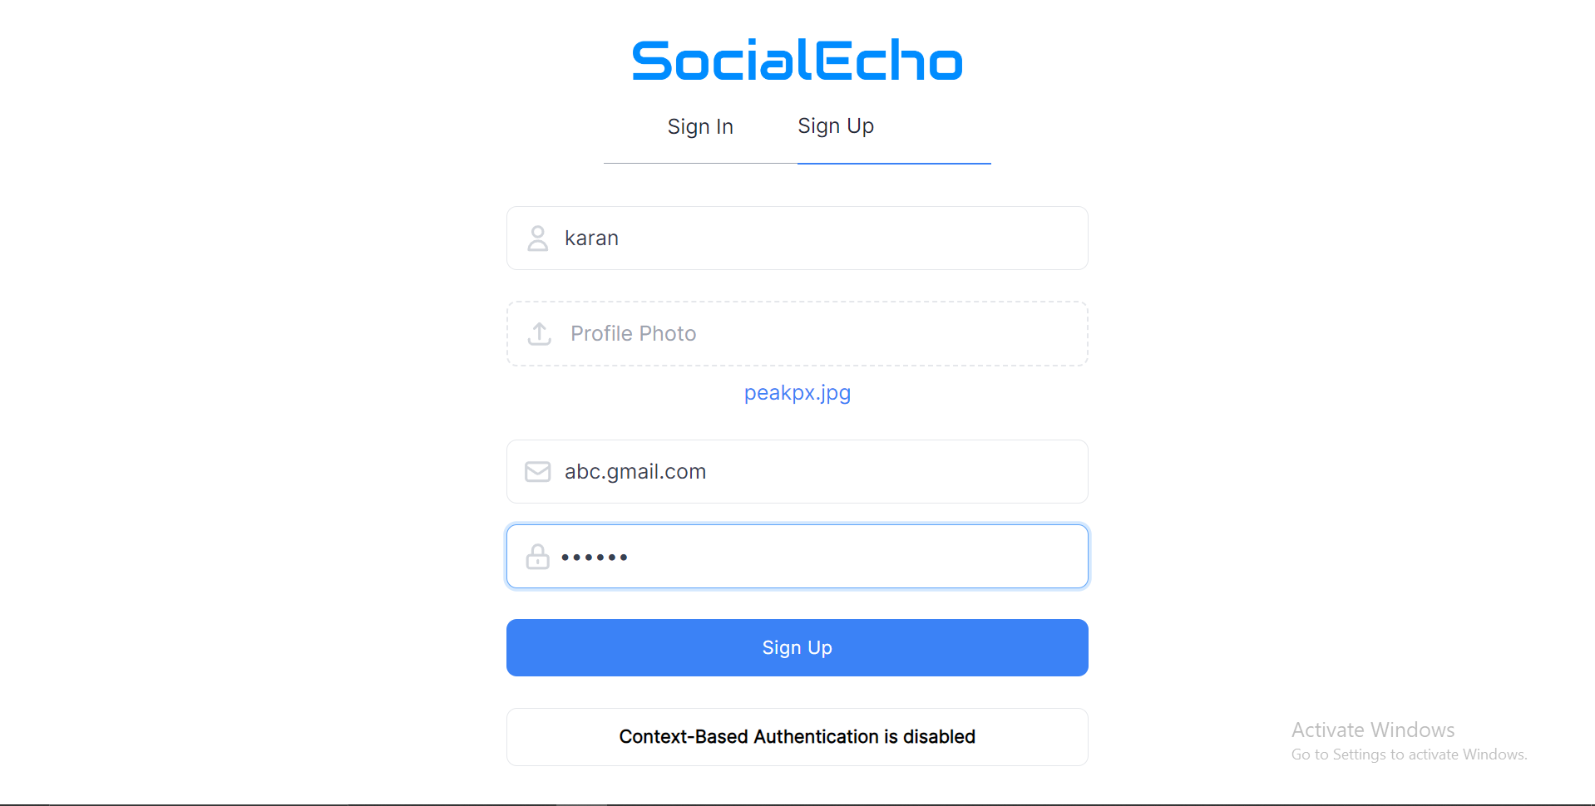
SOCIAL ECHO HTML – CSS – REACT JS – MONGO DB

Slide 7
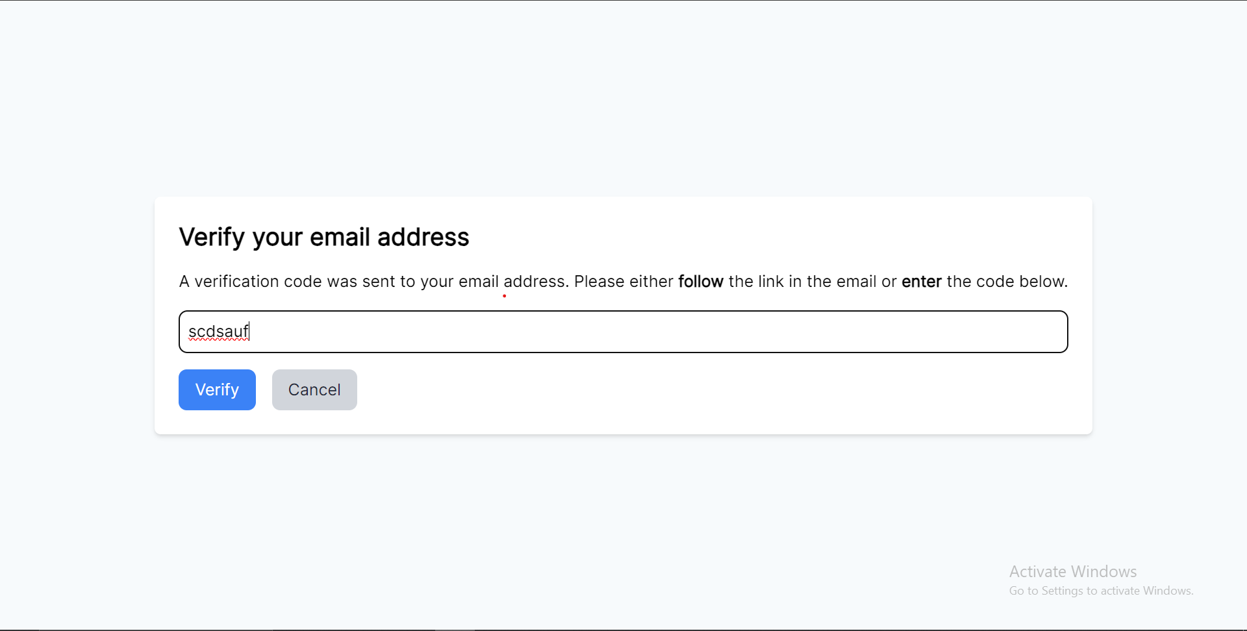
SOCIAL ECHO HTML – CSS – REACT JS – MONGO DB

Slide 8
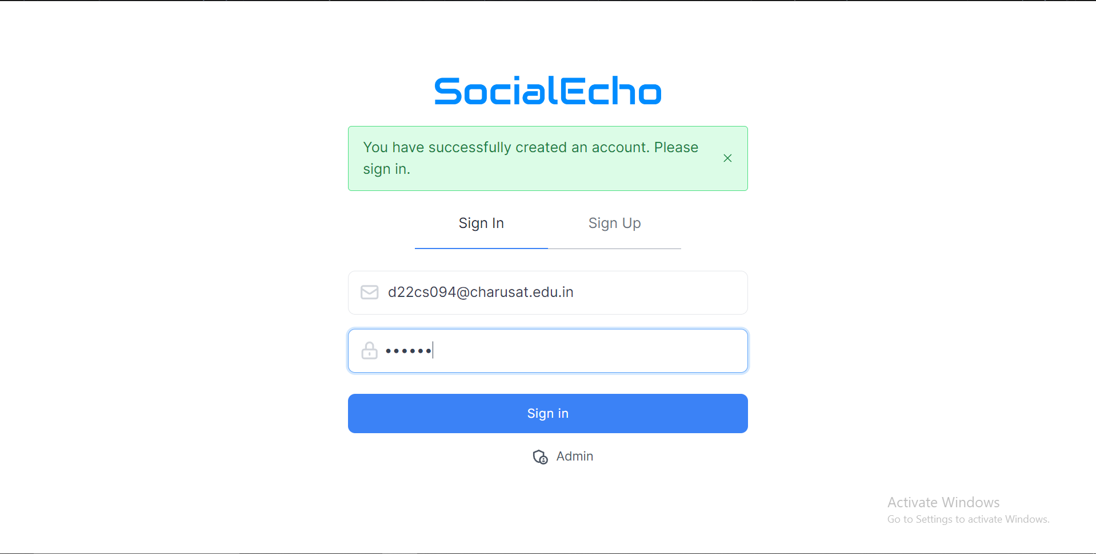
SOCIAL ECHO HTML – CSS – REACT JS – MONGO DB

Slide 9
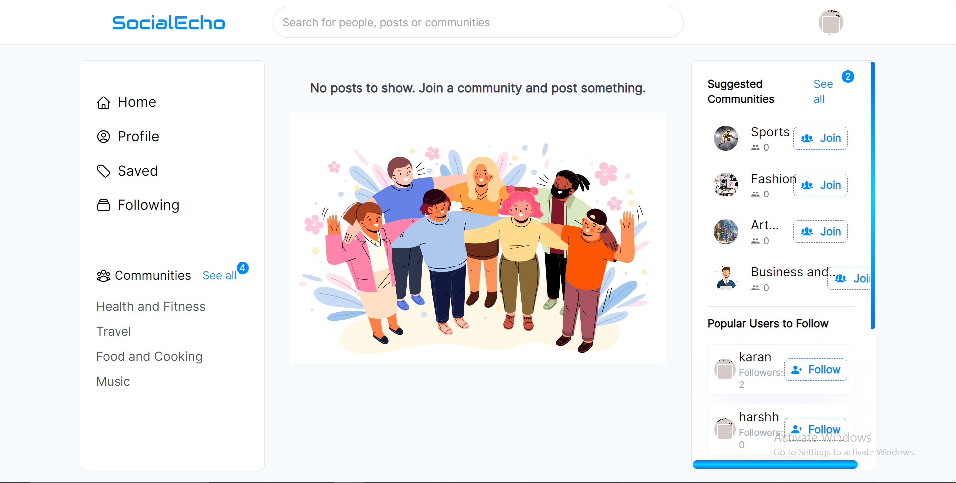
SOCIAL ECHO HTML – CSS – REACT JS – MONGO DB

Slide 10
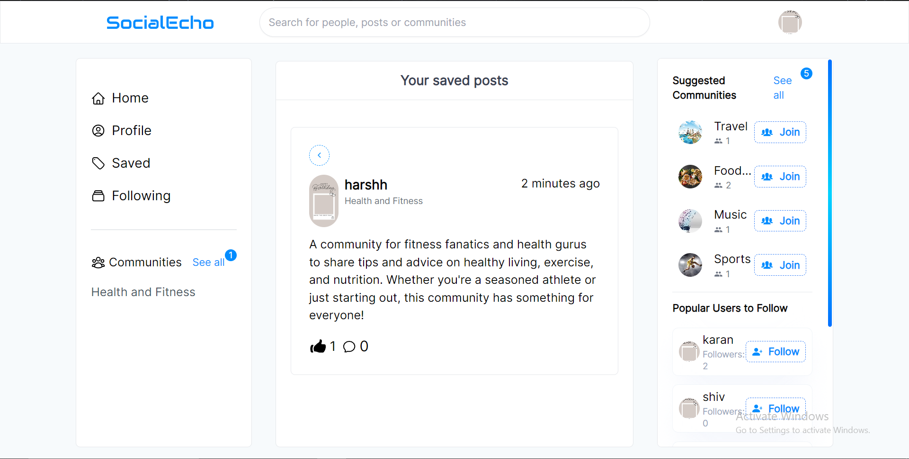
SOCIAL ECHO HTML – CSS – REACT JS – MONGO DB

Slide 11
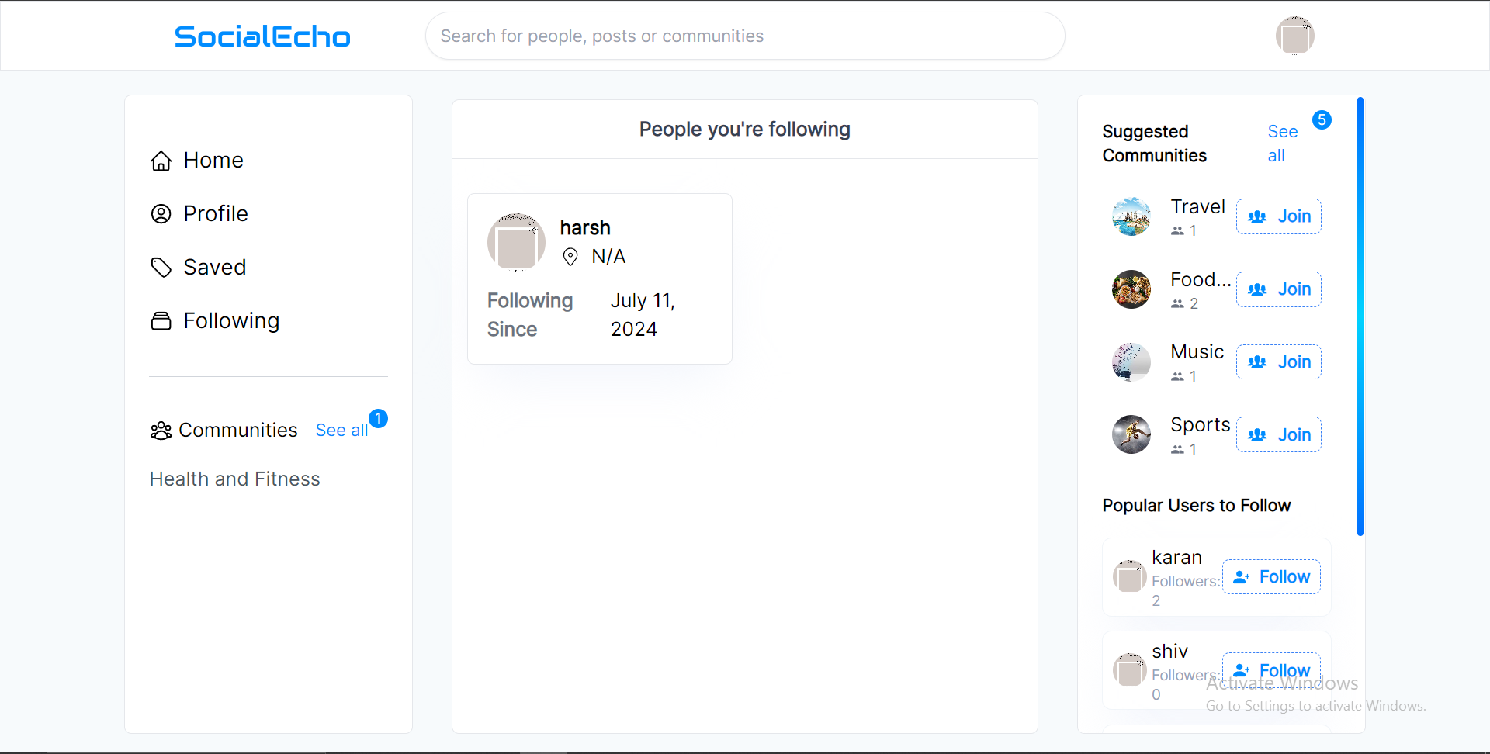
SOCIAL ECHO HTML – CSS – REACT JS – MONGO DB

Slide 12
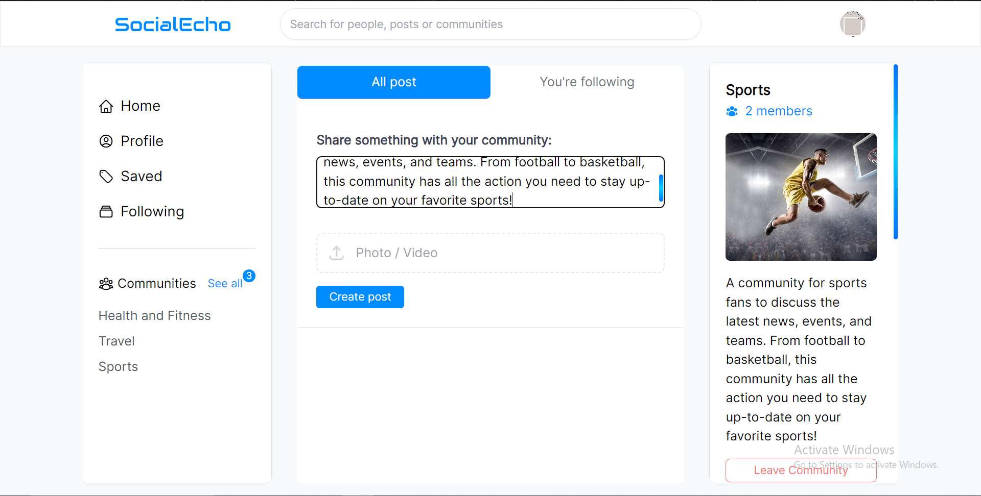
SOCIAL ECHO HTML – CSS – REACT JS – MONGO DB

Slide 13
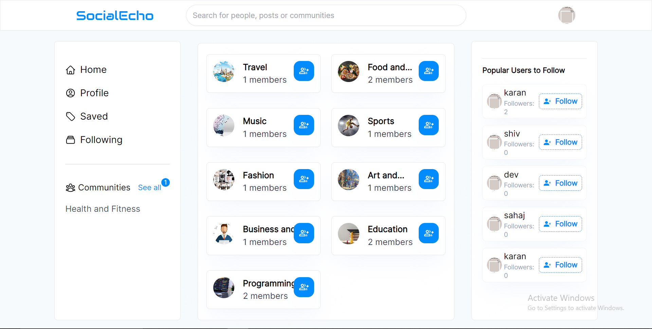
SOCIAL ECHO HTML – CSS – REACT JS – MONGO DB

Slide 14
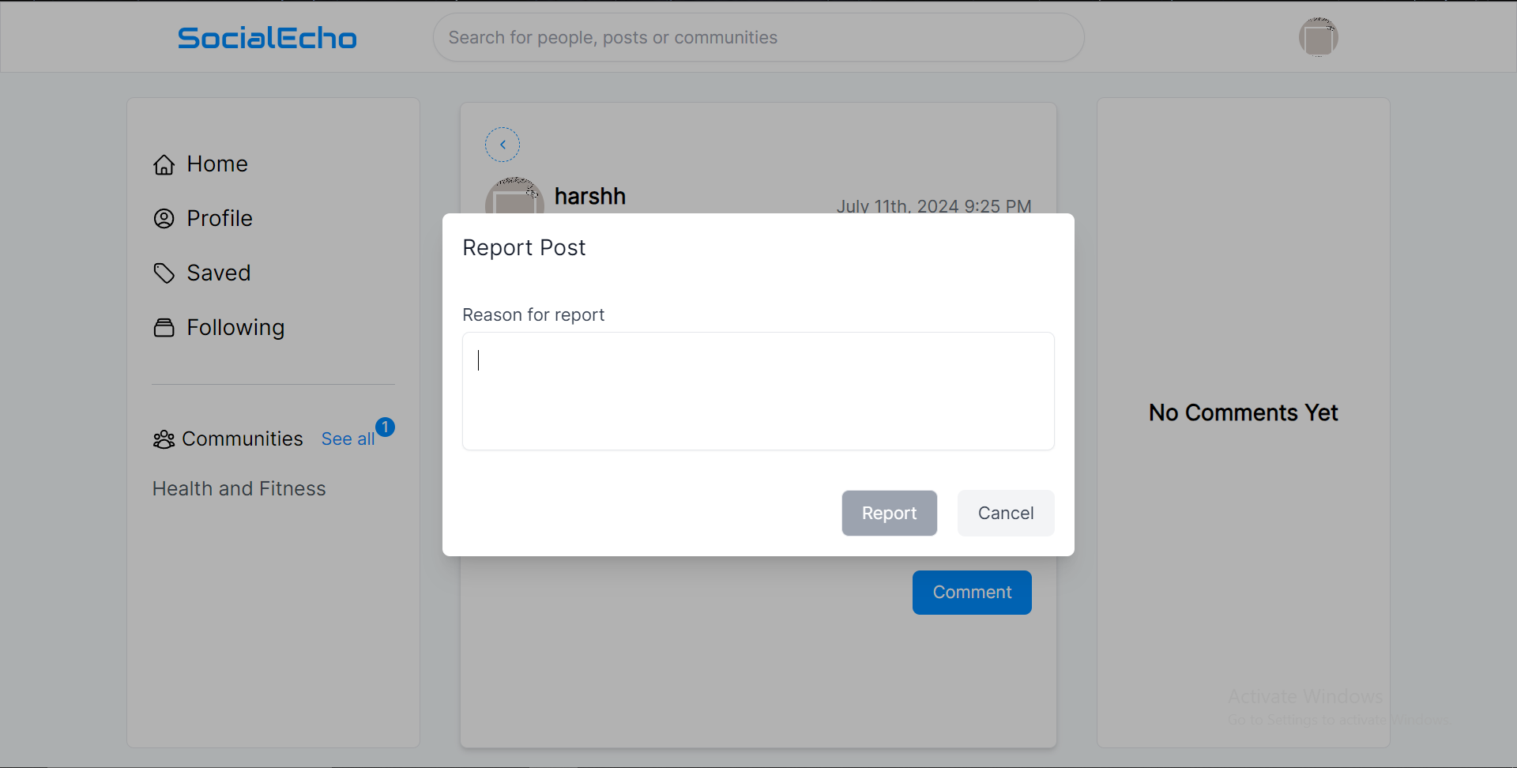
SOCIAL ECHO HTML – CSS – REACT JS – MONGO DB

Slide 15
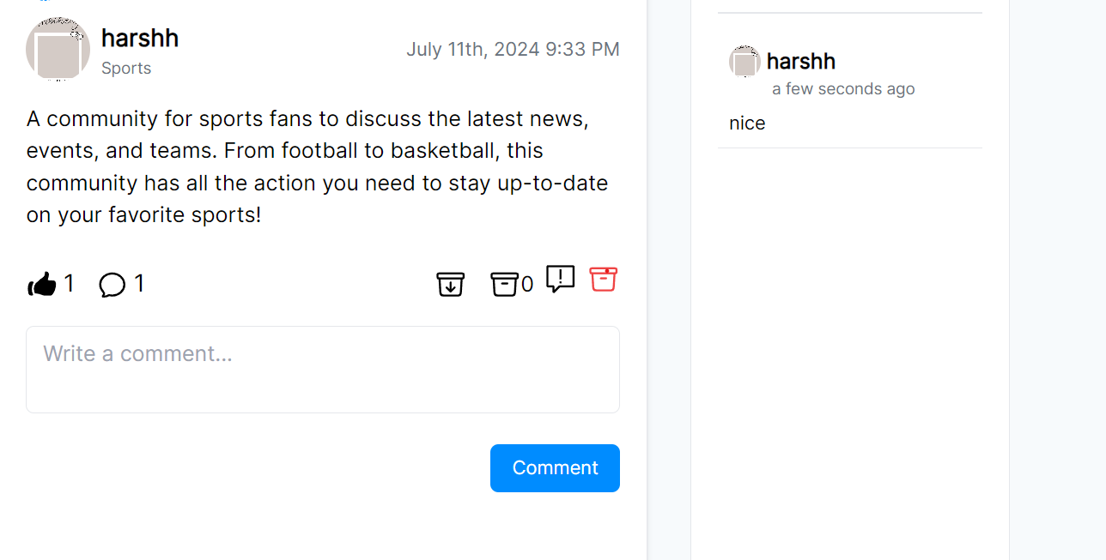
SOCIAL ECHO HTML – CSS – REACT JS – MONGO DB

Slide 16
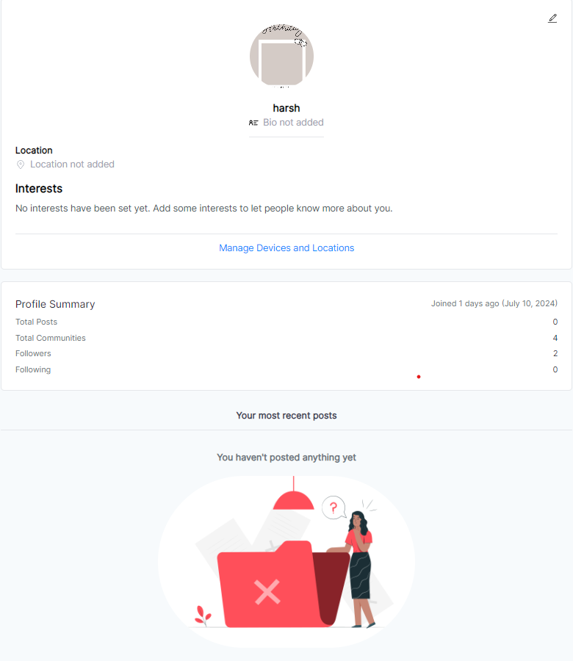
SOCIAL ECHO HTML – CSS – REACT JS – MONGO DB

Slide 17
SOCIAL ECHO HTML – CSS – REACT JS – MONGO DB

Slide 18
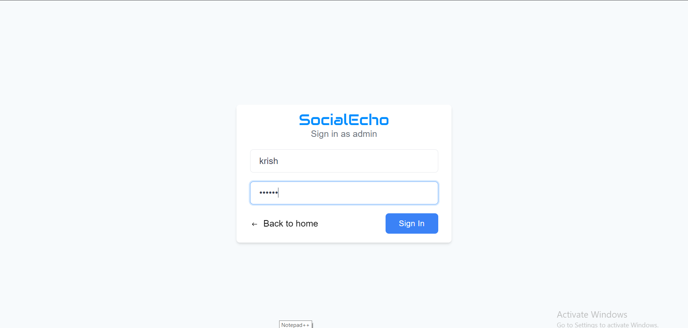
SOCIAL ECHO HTML – CSS – REACT JS – MONGO DB

Slide 19
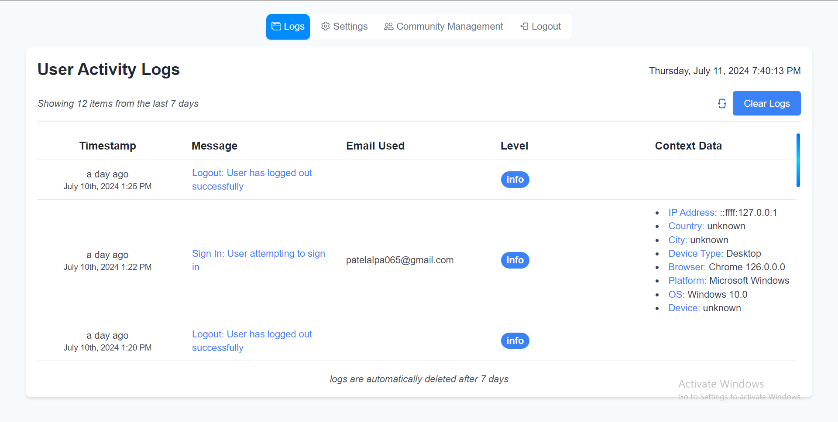
SOCIAL ECHO HTML – CSS – REACT JS – MONGO DB

Slide 20
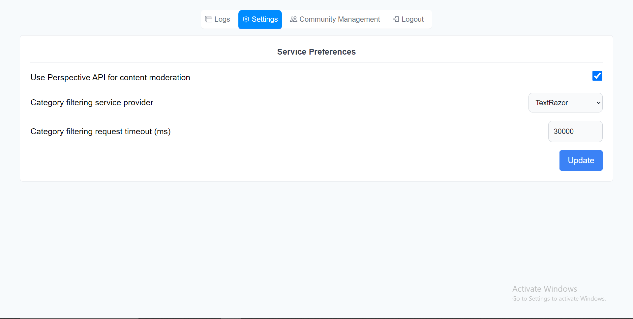
SOCIAL ECHO HTML – CSS – REACT JS – MONGO DB

Slide 21
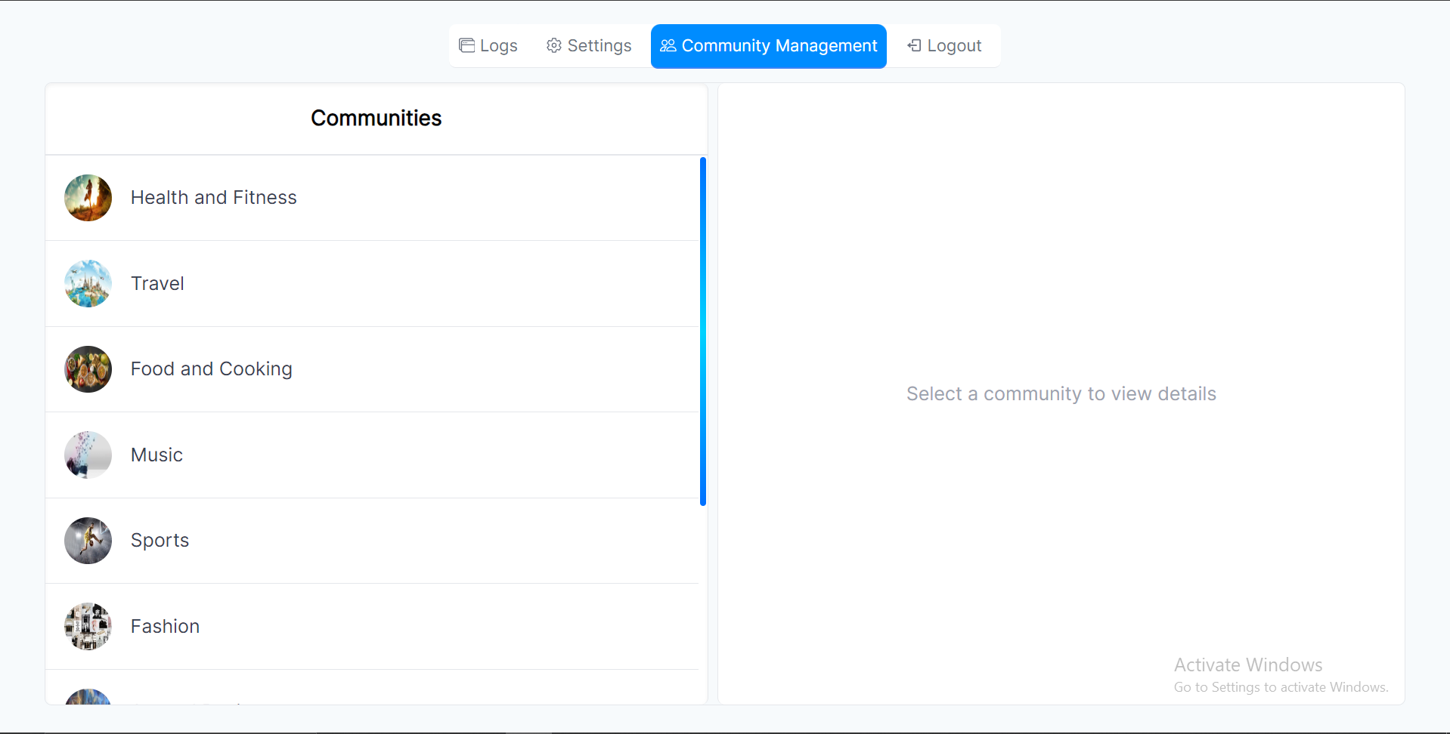
SOCIAL ECHO HTML – CSS – REACT JS – MONGO DB

Slide 22
ADVANTAGES OF INTERNSHIP
Mentorship and Guidance:
we have the opportunity to work closely with experienced professionals who act as mentors or supervisors. These mentors provide guidance, feedback, and support throughout the internship, helping interns develop their skills and navigate their responsibilities.
Collaboration and Networking: Internships provide opportunities to collaborate with colleagues and build professional networks. Interns may participate in team meetings, brainstorming sessions, or collaborative projects, allowing them to interact with professionals from different departments or teams.
Industry Exposure:
You can gain a better understanding of how organizations operate, the technologies they use, and the workflows they follow
It also allows us to understand the industry dynamics, trends, challenges, and best practices.

Slide 23
ADVANTAGES OF INTERNSHIP
Mentorship and Guidance:
we have the opportunity to work closely with experienced professionals who act as mentors or supervisors. These mentors provide guidance, feedback, and support throughout the internship, helping interns develop their skills and navigate their responsibilities.
Collaboration and Networking: Internships provide opportunities to collaborate with colleagues and build professional networks. Interns may participate in team meetings, brainstorming sessions, or collaborative projects, allowing them to interact with professionals from different departments or teams.
Industry Exposure:
You can gain a better understanding of how organizations operate, the technologies they use, and the workflows they follow
It also allows us to understand the industry dynamics, trends, challenges, and best practices.

Slide 24
ADVANTAGES OF INTERNSHIP
Mentorship and Guidance:
we have the opportunity to work closely with experienced professionals who act as mentors or supervisors. These mentors provide guidance, feedback, and support throughout the internship, helping interns develop their skills and navigate their responsibilities.
Collaboration and Networking: Internships provide opportunities to collaborate with colleagues and build professional networks. Interns may participate in team meetings, brainstorming sessions, or collaborative projects, allowing them to interact with professionals from different departments or teams.
Industry Exposure:
You can gain a better understanding of how organizations operate, the technologies they use, and the workflows they follow
It also allows us to understand the industry dynamics, trends, challenges, and best practices.

Slide 25
ADVANTAGES OF INTERNSHIP
Mentorship and Guidance:
we have the opportunity to work closely with experienced professionals who act as mentors or supervisors. These mentors provide guidance, feedback, and support throughout the internship, helping interns develop their skills and navigate their responsibilities.
Collaboration and Networking: Internships provide opportunities to collaborate with colleagues and build professional networks. Interns may participate in team meetings, brainstorming sessions, or collaborative projects, allowing them to interact with professionals from different departments or teams.
Industry Exposure:
You can gain a better understanding of how organizations operate, the technologies they use, and the workflows they follow
It also allows us to understand the industry dynamics, trends, challenges, and best practices.

Slide 26
THANK YOU

Slide 27
Worked At
CAMPUSKNOT EDU.PVT.LTD
Vadodara
as React developer Intern

